Slide 1
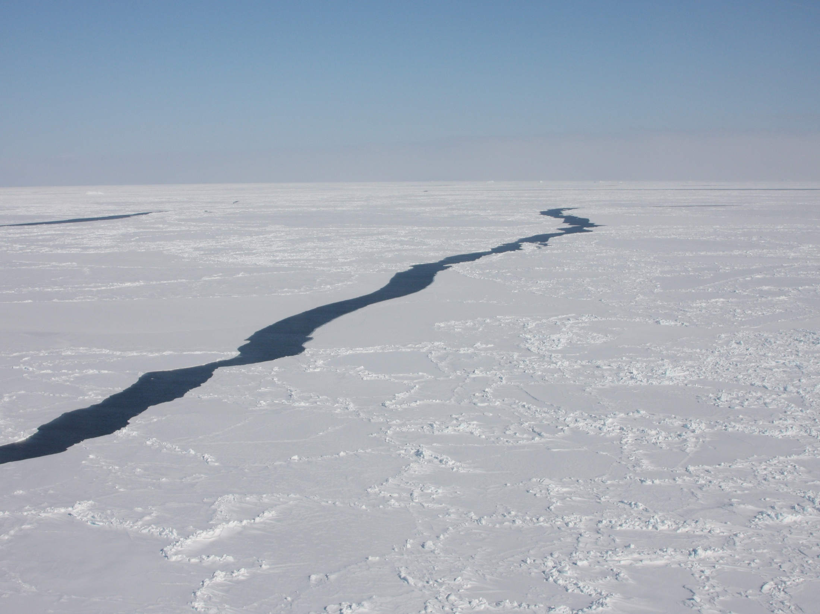
The Arctic sea ice landscape and the movements of narwhals (Monodon monoceros)
Kristin Laidre (University of Washington), Mads Peter Heide-Jørgensen, Harry Stern, Rune Dietz, Pierre Richard

Slide 2
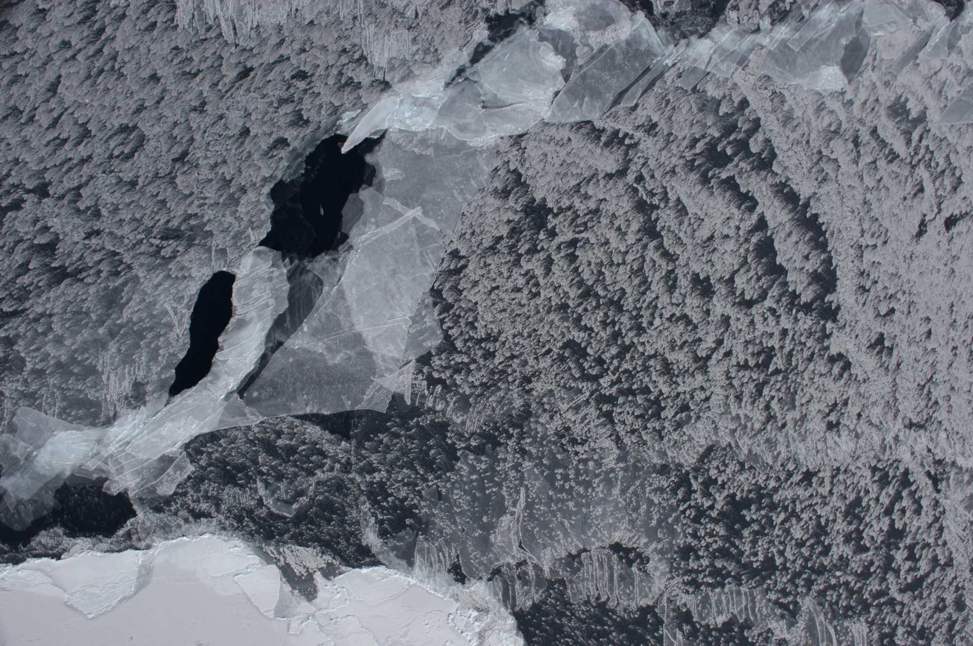
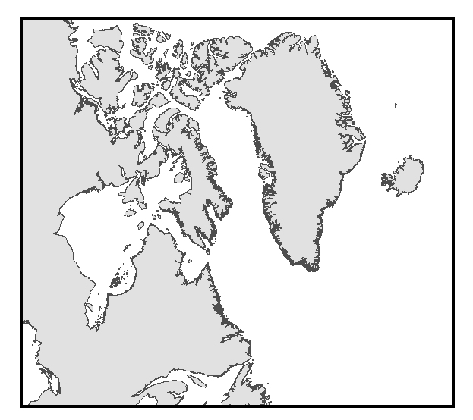
Greenland
Canada

Slide 3
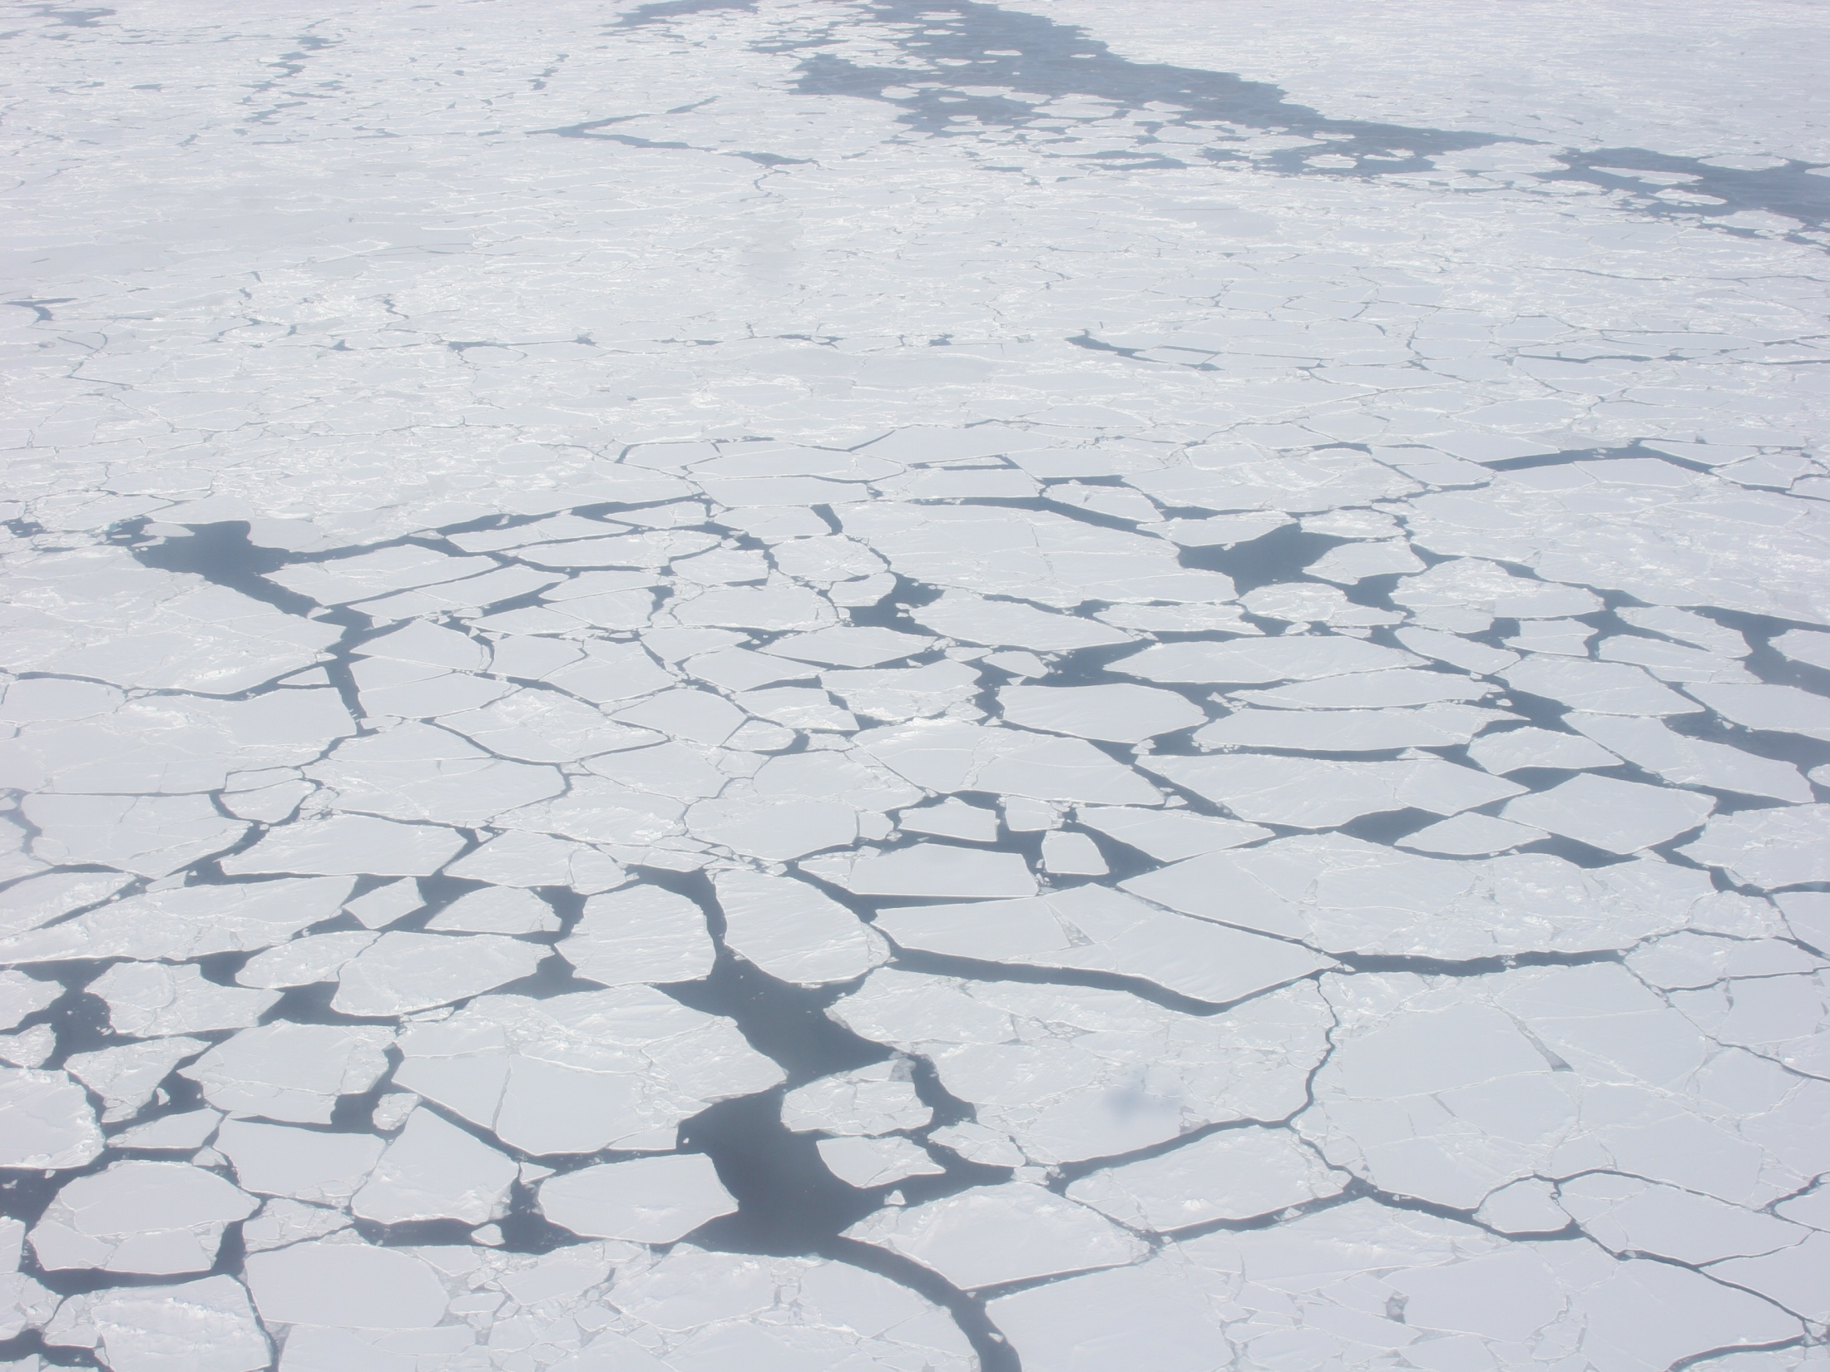
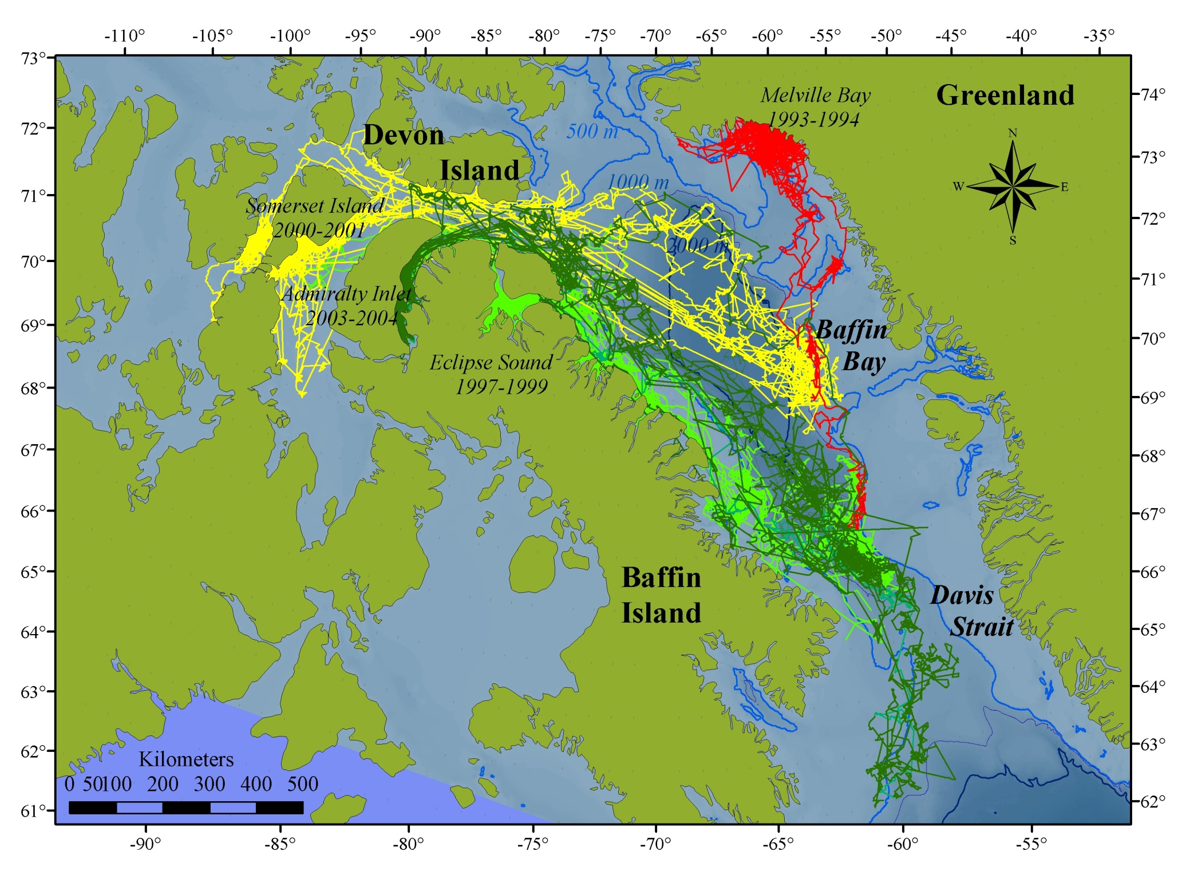
2006-2007
Dietz et al. (2008), Heide-Jørgensen et al. (2003), Laidre et al. (2005)
Notes:
Two decades of satellite tracking studies in eastern Canada and West Greenland have demonstrated 1) migratory corridors, 2) wintering grounds and 3) the general behavioral feature of very high site fidelity for several of the large populations. Cite Dietz et al. 2008, HJ et al. 2003, Laidre et al. 2003 – picture of . Over 80% of the world’s narwhals moves offshore into central BB and DS for winter.

Slide 4
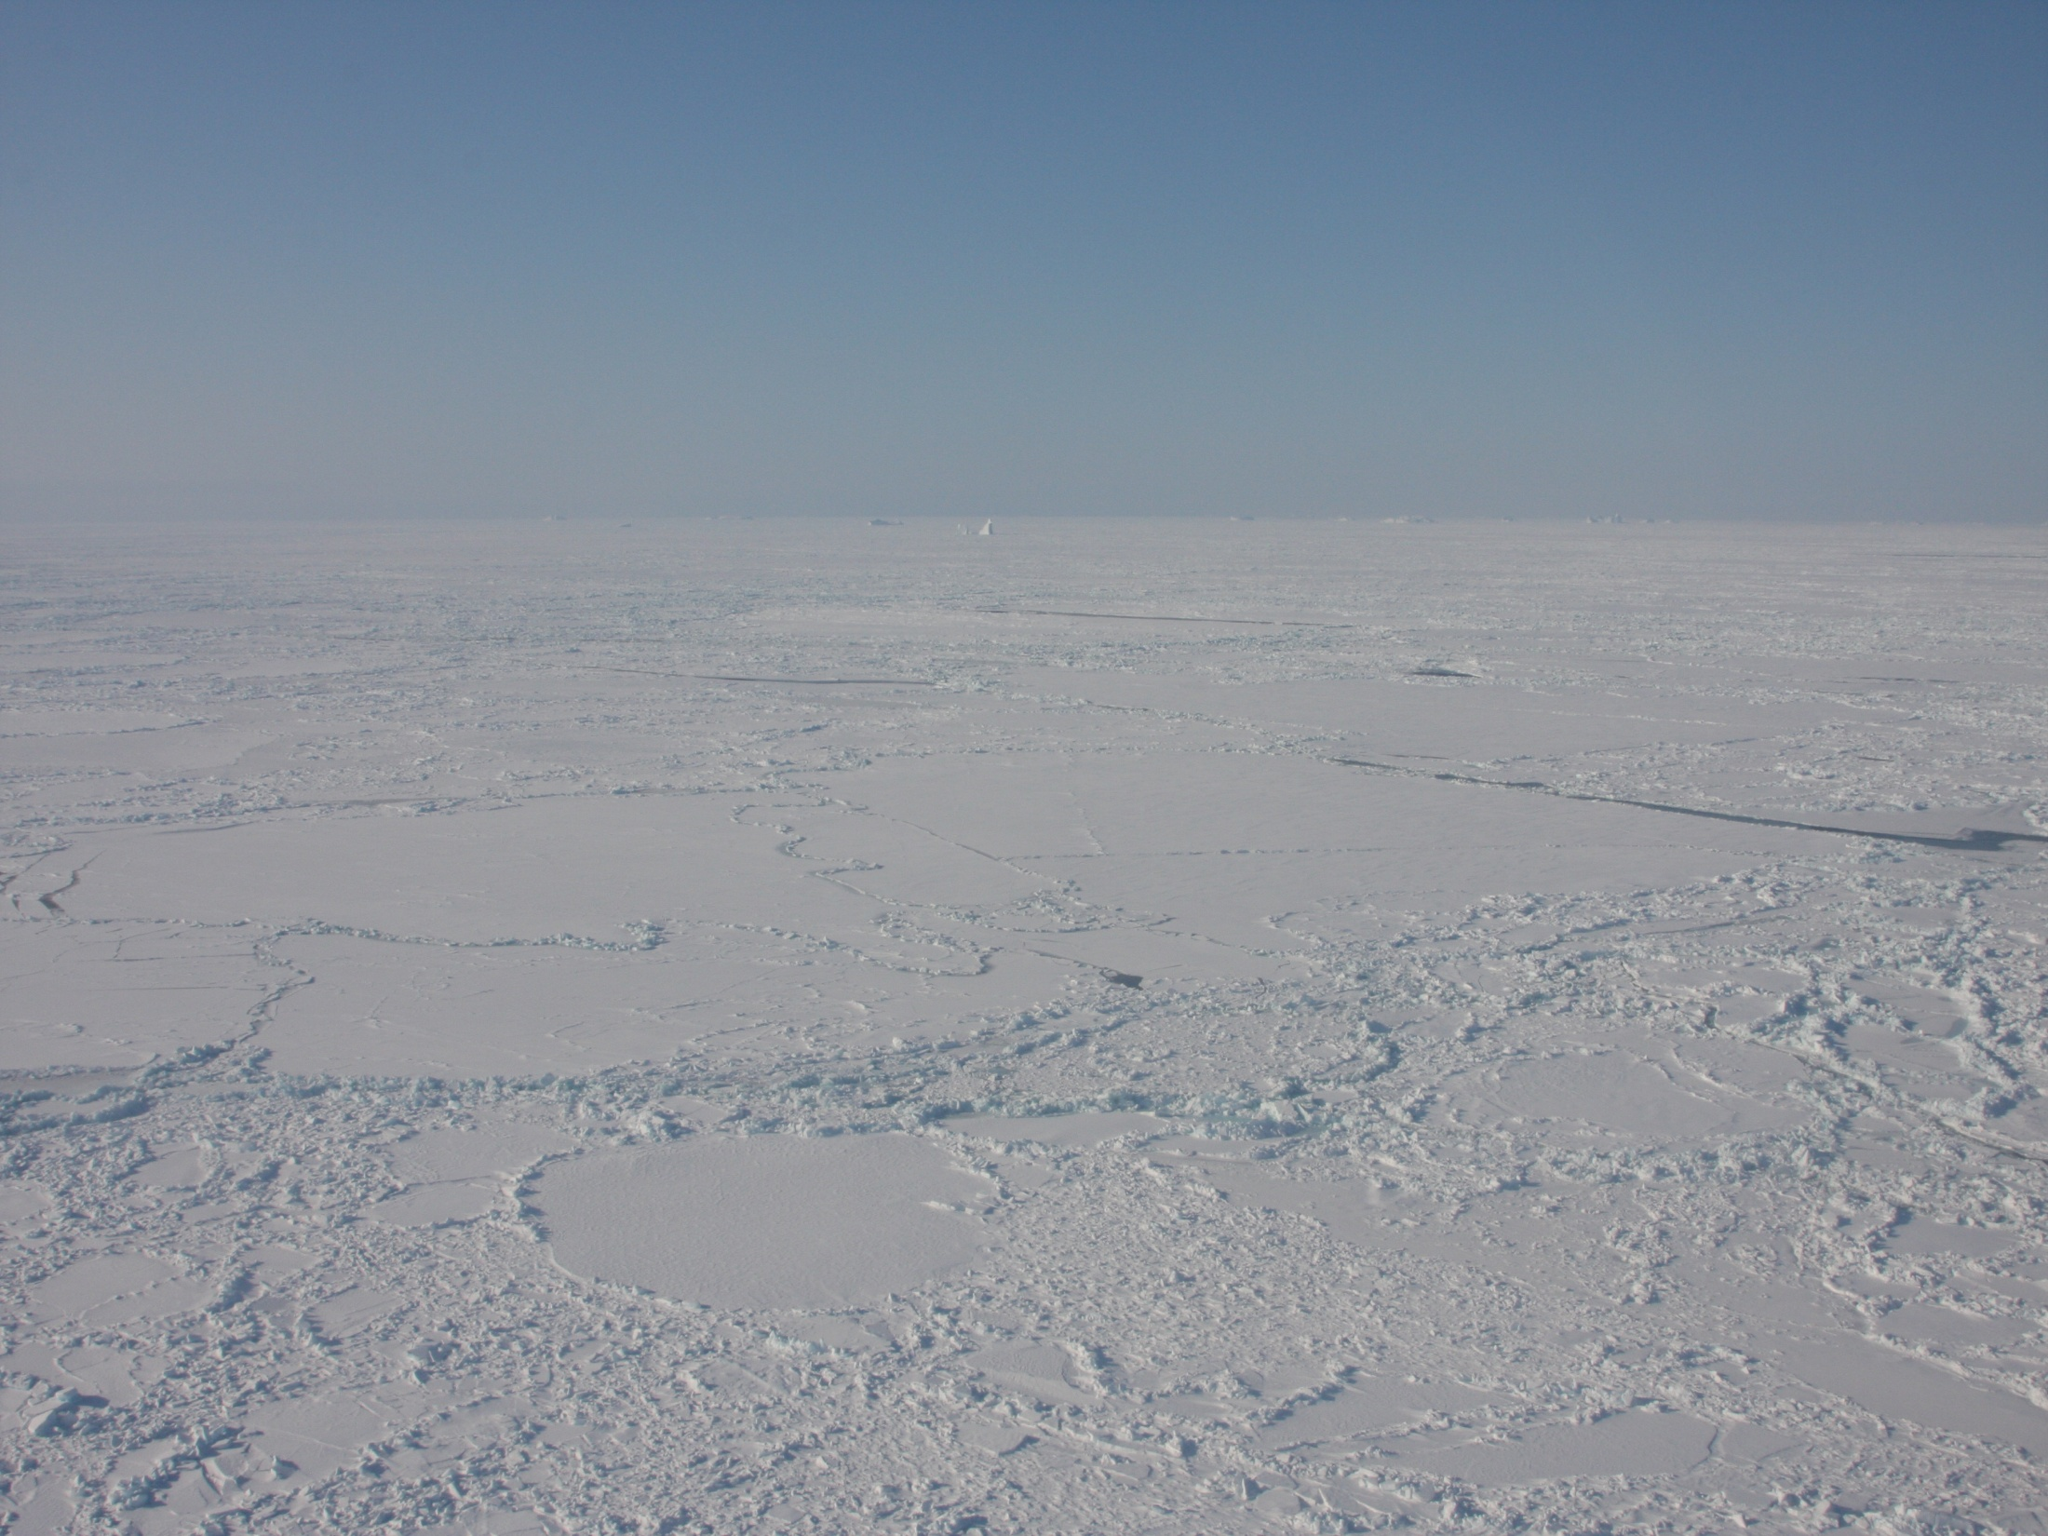
Extensive southbound fall migration that occurs when annual sea ice forms in the summer grounds.
2) Over 80% of the world’s narwhals overwinter in Baffin Bay and Davis Strait for 6 months of the year.
3) High population-level site fidelity to wintering grounds.

Slide 5
Springtime sea ice off West Greenland (Baffin Bay)
Ice is very dynamic, moves >25 km/day
Notes:
Overall trend is a decline in sea ice cover in BB

Slide 6
Background wintertime ecology
Narwhals make deep dives in winter, >1,800 m 15x per day
Narwhals feed almost exclusively on Greenland halibut in Baffin Bay
Laidre et al. (2003), Laidre and Heide-Jørgensen (2005)
Notes:
These studies have also facilitated ecological studies that have demonstrated the winter period in the Baffin Bay ice is one of the most important periods of the year for narwhals. Narwhals feed intensively during this time, primary on Greenland halibut and make dives to >1500 m to reach their prey
Looked at dive behavior between several populations
Examined over 500 stomachs from – clear picture emerges that there is very little feeding in summer and

Slide 7

Winter is a critical feeding period for 6 months of the year
Laidre et al. (2004a,b), Laidre and Heide-Jørgensen (2005)

Slide 8
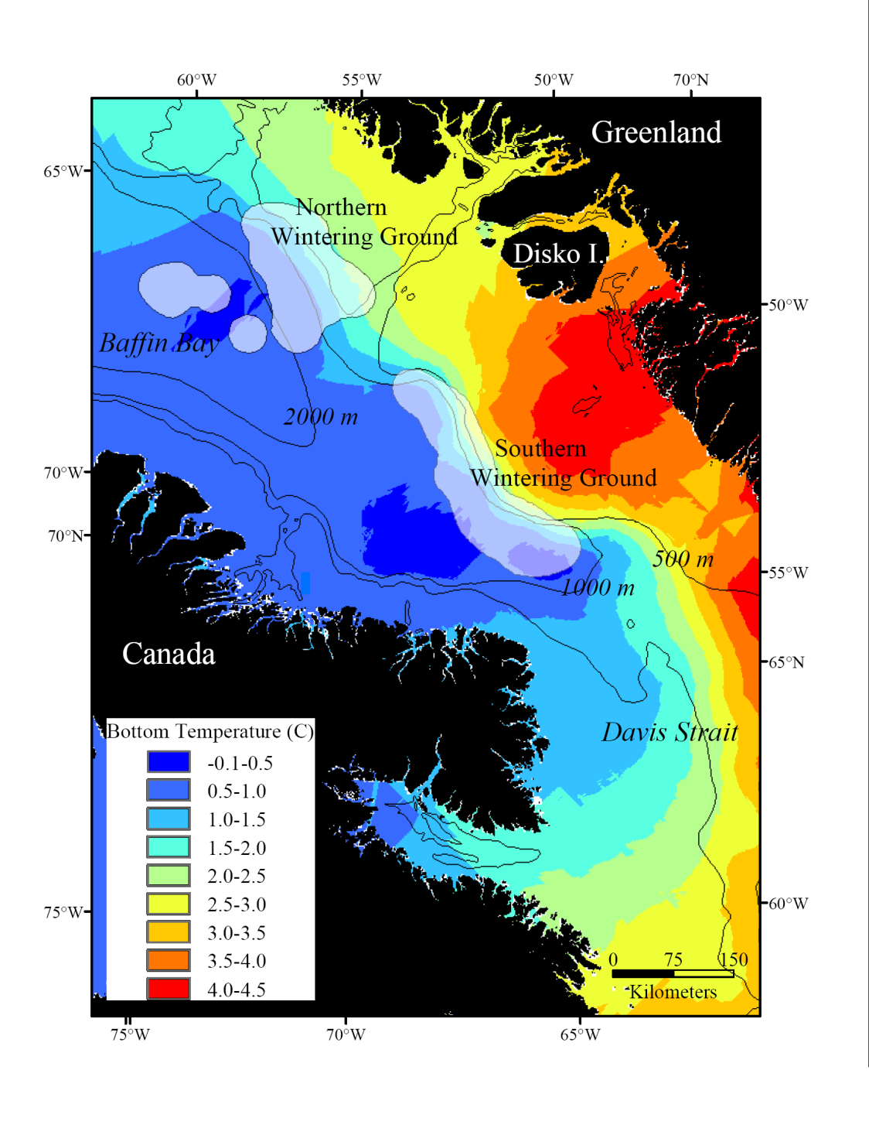
These studies have also demonstrated there are preferred feeding areas on the slope and the more productive east side of Baffin Bay
Laidre et al. (2004b)
Notes:
Irminger current and GHL recruitment from the southern tip of Greenland

Slide 9
Questions:
1- Do changes in annual sea ice conditions influence overwintering areas and movements?
2- What is the density and abundance on the wintering grounds?
3- How to quantify sea ice habitat and complexity?
Notes:
The winter period is unfortunately a very difficult time of year to study narwhals because they are located 200 km offshore, most of the season is dark with temperatures below -30, and the pack ice is >95% concentration. However, given the importance of this season, coupled with the obvious physical and ecological changes manifested through climate change, there is critical importance to study narwhals during this season.
Not necessarily easy to answer since we cant experiment with the sea ice and we must control for inter-population variability.

Slide 10
Kakiak Point, Admiralty Inlet, Canada 2003-2005
N=13 whales tagged in 2003
N=8 whales tagged in 2004
N=13 whales tagged in 2005
Positions until March/April the following year.
Notes:
Tagged a total of 34 whales over 3 year period from the same summering ground.

Slide 11
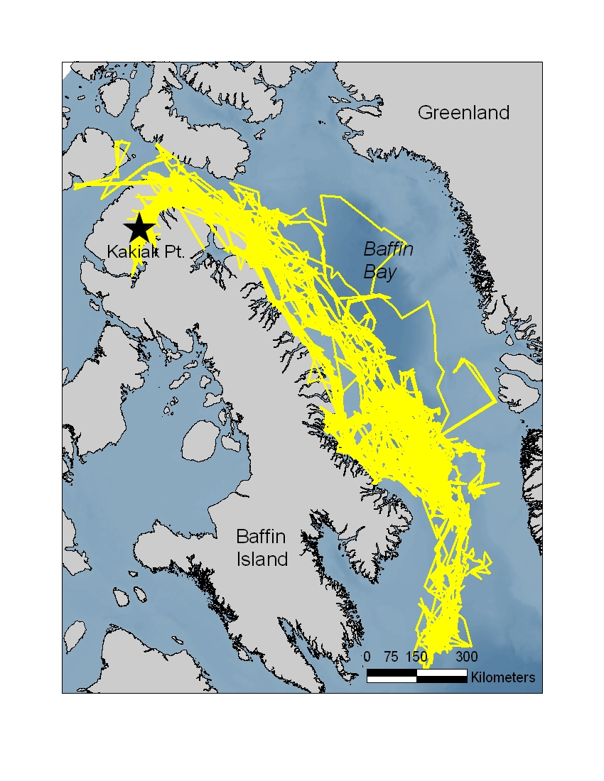

Slide 12
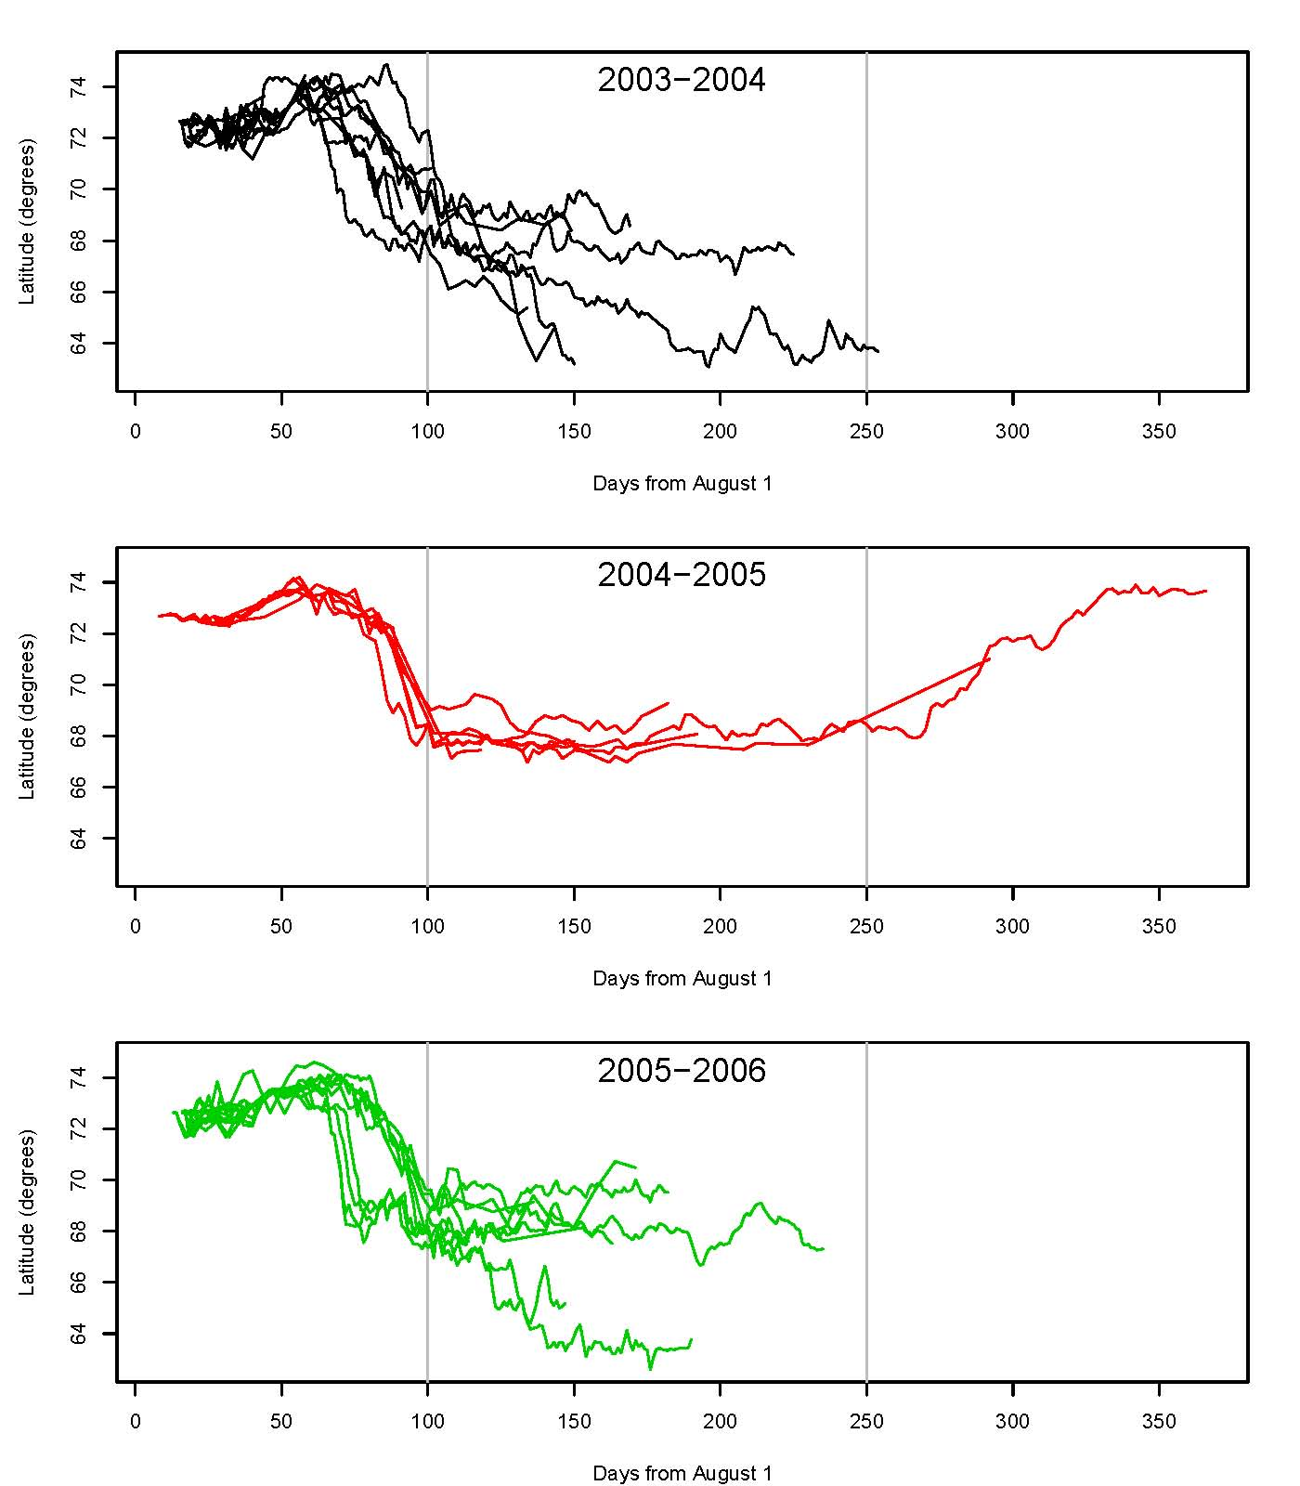

Slide 13
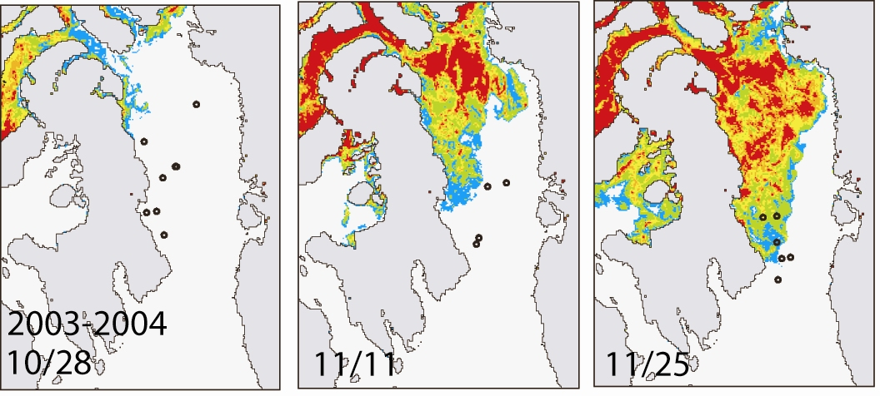
Migration
Ice data: AMSR-E

Slide 14
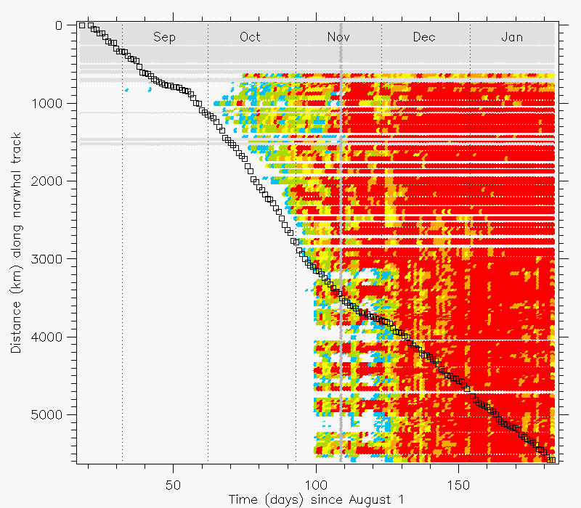

Fall migration occurs ahead of the forming fast ice
Notes:
This plot illustrates the narwhal swimming just ahead of the advancing sea ice in October and the sea ice catches up to the narwhal around Nov 10. After the first week of December the narwhal is in heavy pack ice (>95%). The narwhal’s velocity was relatively slow in August and September (shallow slope of black boxes), then speeds up in October (steeper slope).

Slide 15
Winter

Slide 16
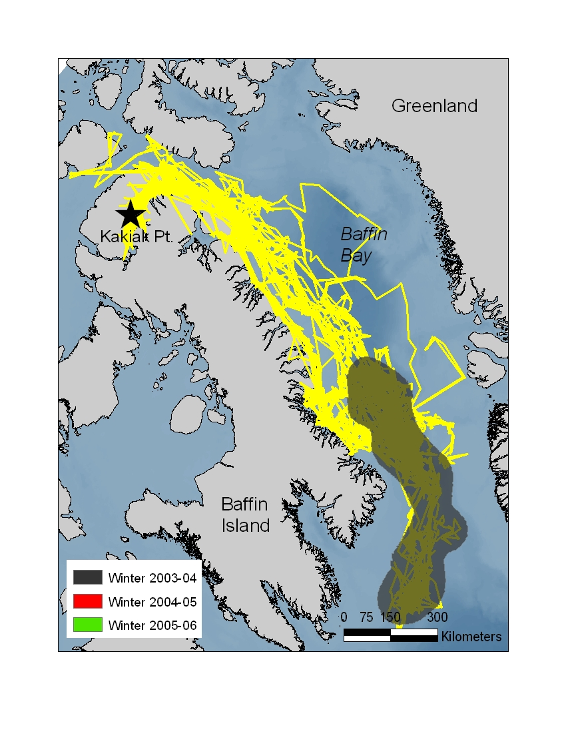
Winter

Slide 17
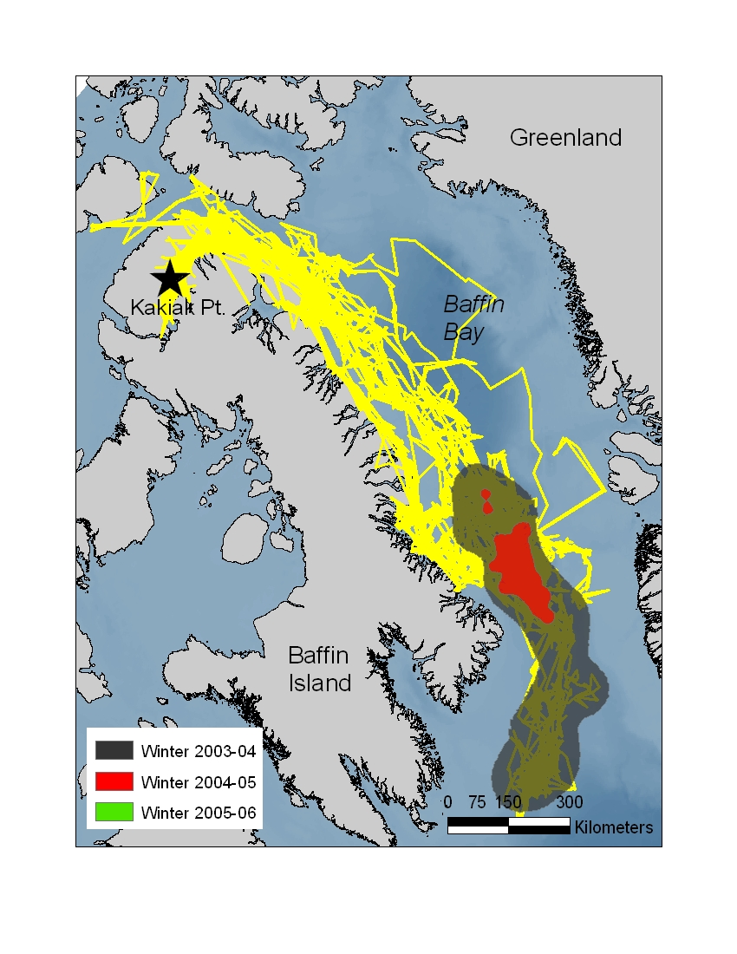
Winter

Slide 18
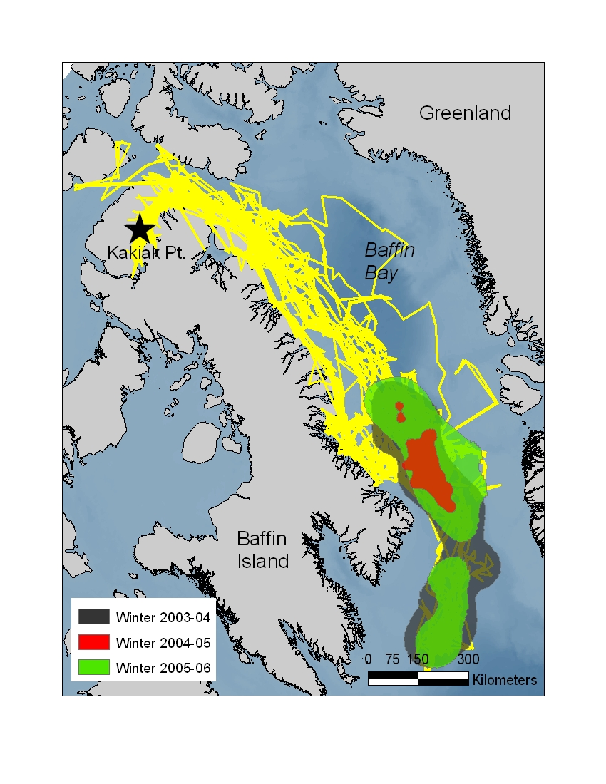
Winter

Slide 19
Winter kernel home ranges (km²) between 15 November and 15 April
Years | N whales | 95% home range | 75% home range | 50% home range
2003-2004 | 6 | 153,587 | 46,678 | 10,360
2004-2005 | 6 | 21,084 | 9,319 | 3,506
2005-2006 | 9 | 128,932 | 34,419 | 9,769
Notes:
No difference in n of whales tracked during the 3 winters
Standardizes for interpopulatoin variability, just looking at whales from a single population

Slide 20
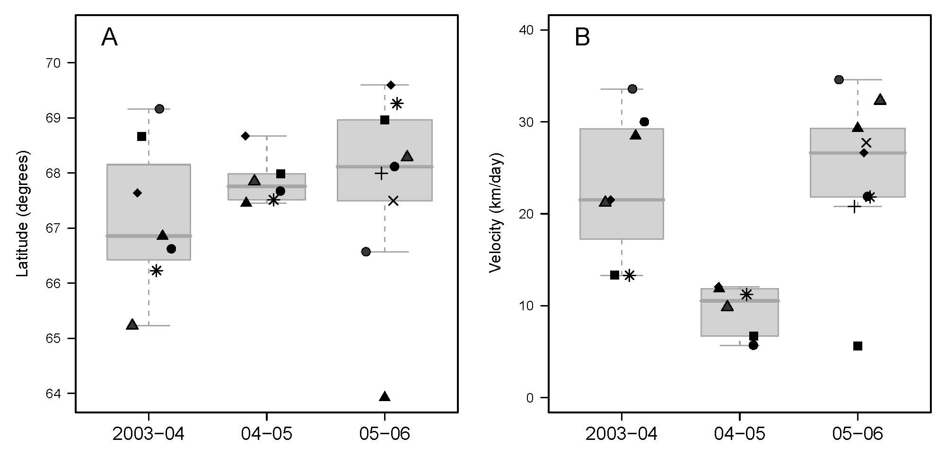
Median Latitude
Median Velocity
Notes:
Horizontal line indicates median response, bottom and top of box show 25 and 75 percentiles respectively. Significant differences were found between daily velocities each year (difference driven by 2004-05 season) but no differences were found between latitude with year.

Slide 21
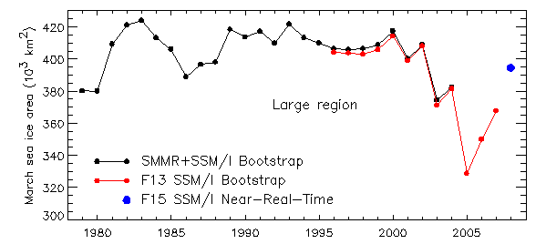
Annual sea ice cover in Baffin Bay

Slide 22
Narwhals had largest ranges and highest velocities in years with the greatest sea ice cover.
Heavy ice years require whales to conduct compensatory movements to keep up with moving leads and cracks and remain over preferred foraging areas.
Light ice years lead to more stationary behavior over preferred areas for longer periods and lower velocities.

Slide 23
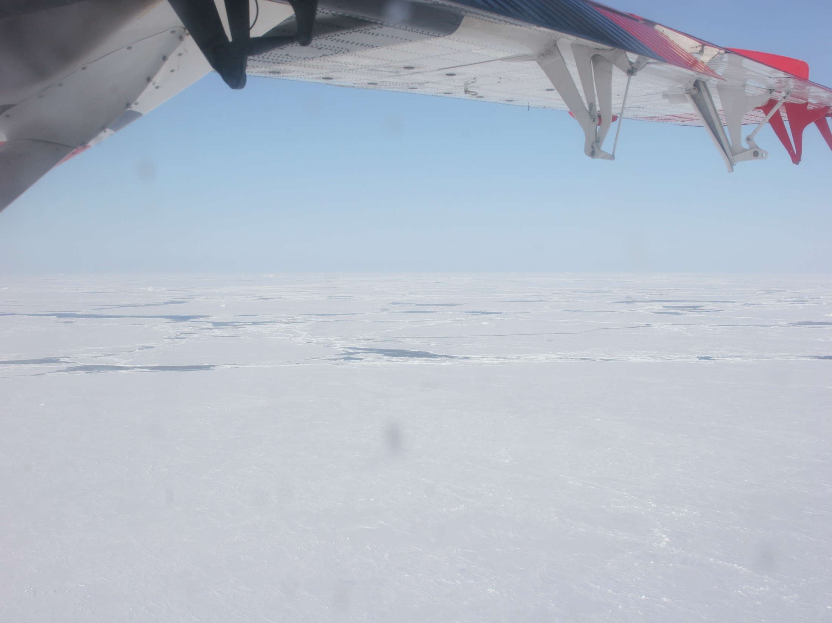
April 2008 survey of narwhal wintering grounds
Double platform visual aerial survey
Long range fuel tank
Twin Otter with bubble windows

Slide 24
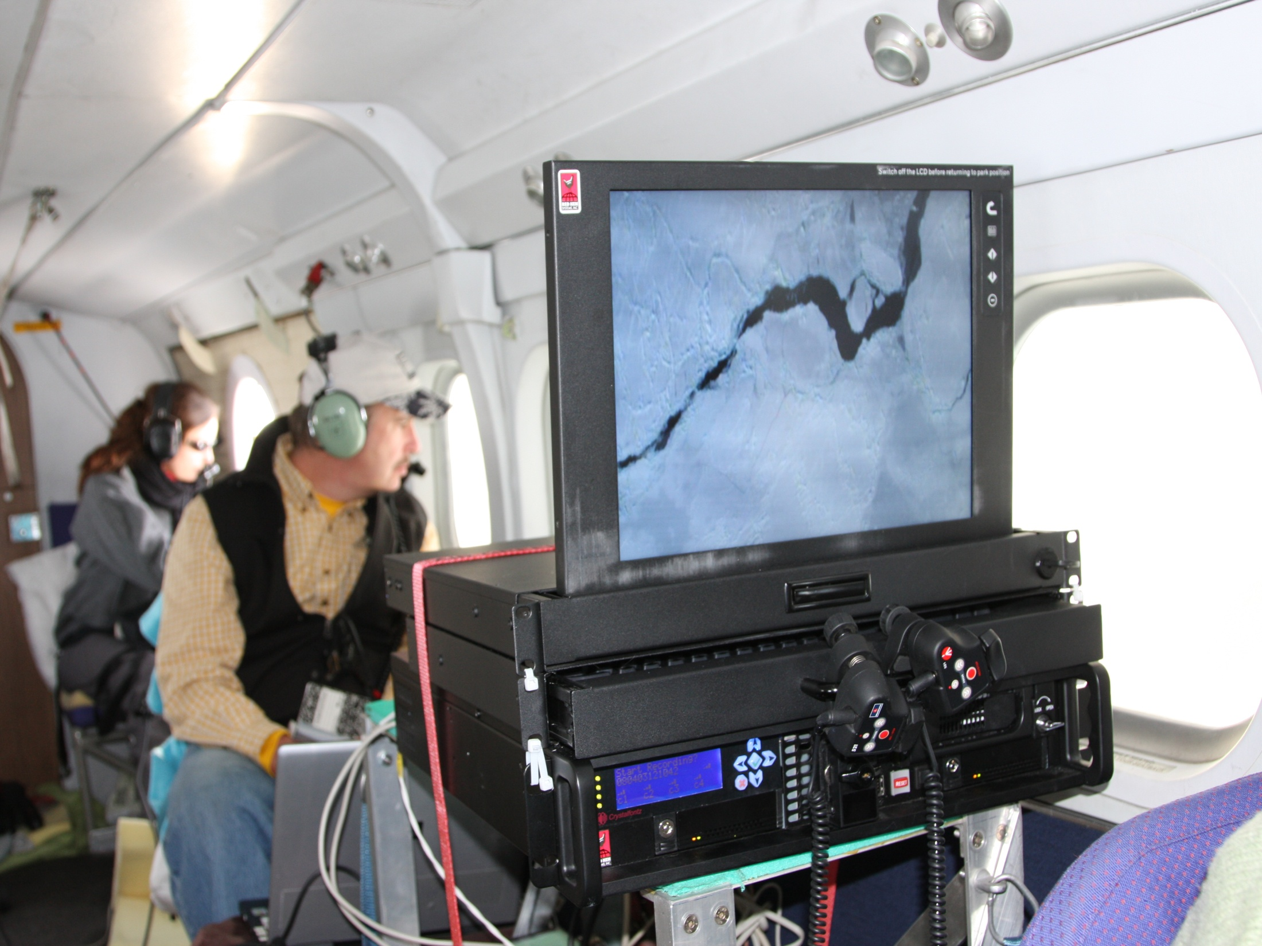
Sightings and trackline recorded on a Redhen msDVRs system
Continuous video recording of trackline and digital photography

Slide 25
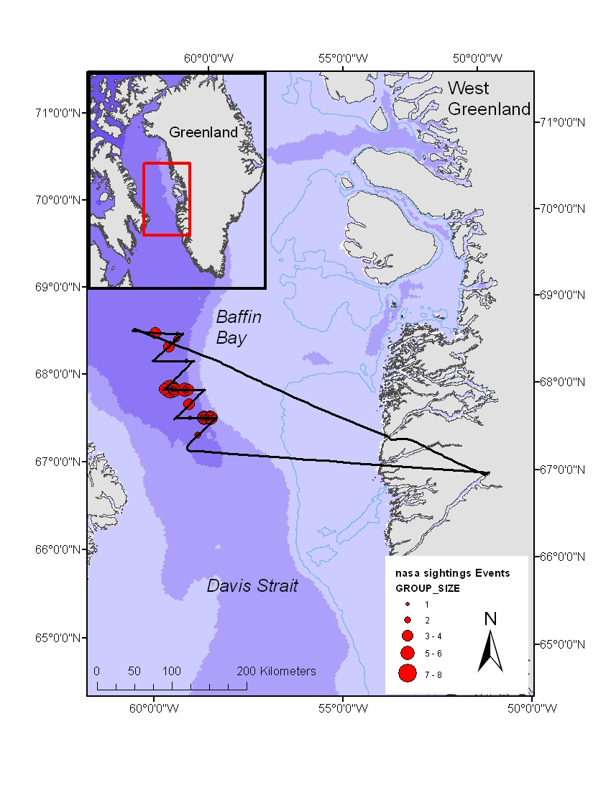
8 zig-zag transects flown 250 km from shore on a single day
Declination angle to sightings measured and converted to perpendicular distance

Slide 26
Two abundance estimates developed:
Conventional distance sampling (CDS) using 44 sightings from the front observers only.
Point conditional mark-recapture (MR) distance sampling allowing for double-platform estimation of 57 sightings (a fully corrected survey specific abundance estimate).
17,239 (CV 0.58)
19,356 (CV 0.45)
Both approaches: 9,514 km² and 405 km of effort
Notes:
Detection probability of pooled detections from both rear and front observers. The distances of sightings was truncated at 700 m. The points are the probability of detection for each sighting given its perpendicular distance and other covariate values. The line is a smooth function fitted to the points.

Slide 27
Quantifying sea ice habitat for narwhals:
MODIS satellite images on cloud-free days
High resolution low altitude continuous digital photography on survey track

Slide 28
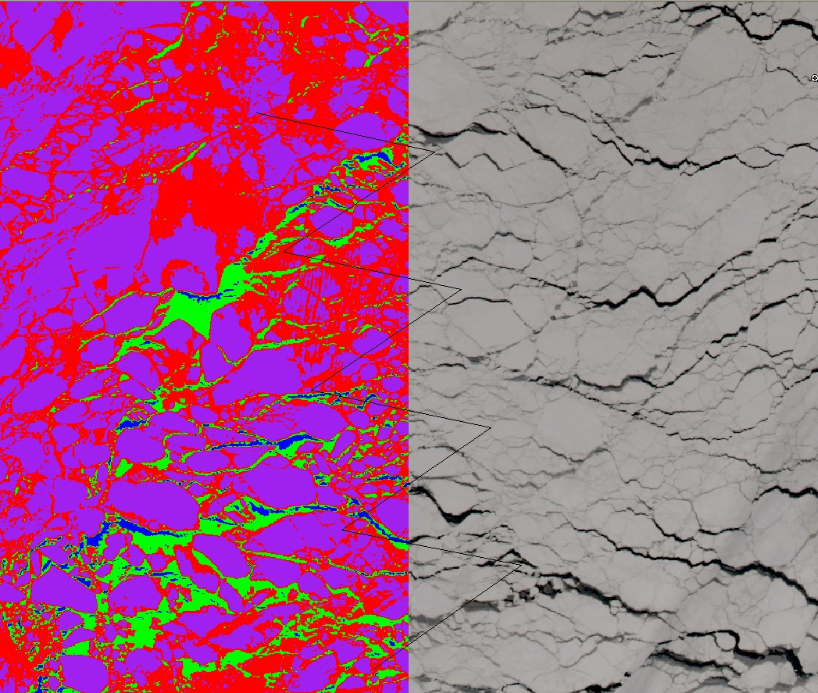
MODIS sea ice clustering algorithm
Multi-spectral 250 m resolution image classified into four classes of sea ice:
open water
light pack/new ice
medium pack
heavy pack, including ridges and dense snow cover
using the Isodata clustering algorithm (ERDAS Imagine 9.2)
Notes:
Based upon the strength of absorption and reflectance at these wavelengths, the clustering algorithm achieved 95% confidence in assigning each 250 meter grid cell to the most similar classification of sea ice type.

Slide 29
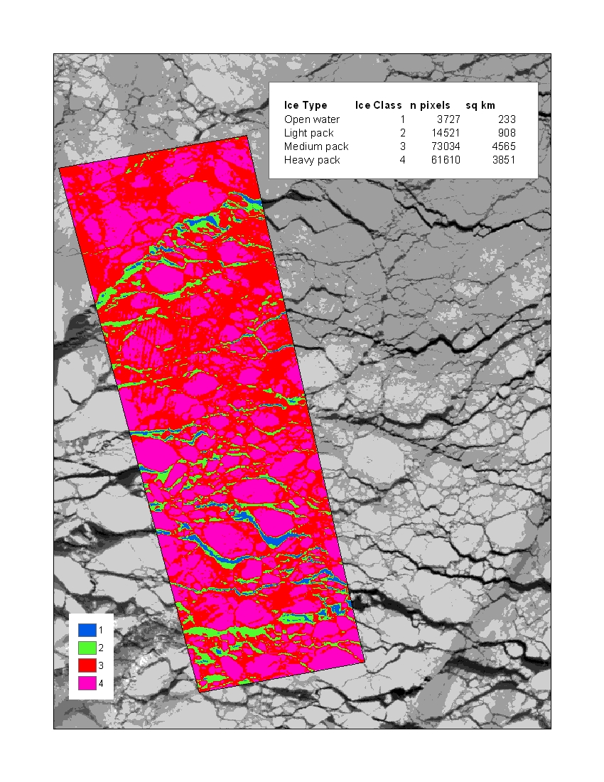
233 km² of open water in the ~9500 km² survey area
2.4% of the survey region
A density of ~73 narwhals km² of open water
Including the light ice category amounts to an additional 908 km² of habitat
Notes:
Multi-spectral image (205 m) classified into four classes of sea ice:
open water,
light pack ice or new ice,
medium pack, and
heavy pack including ridges and dense snow cover
using the Isodata clustering algorithm available in ERDAS Imagine 9.2

Slide 30
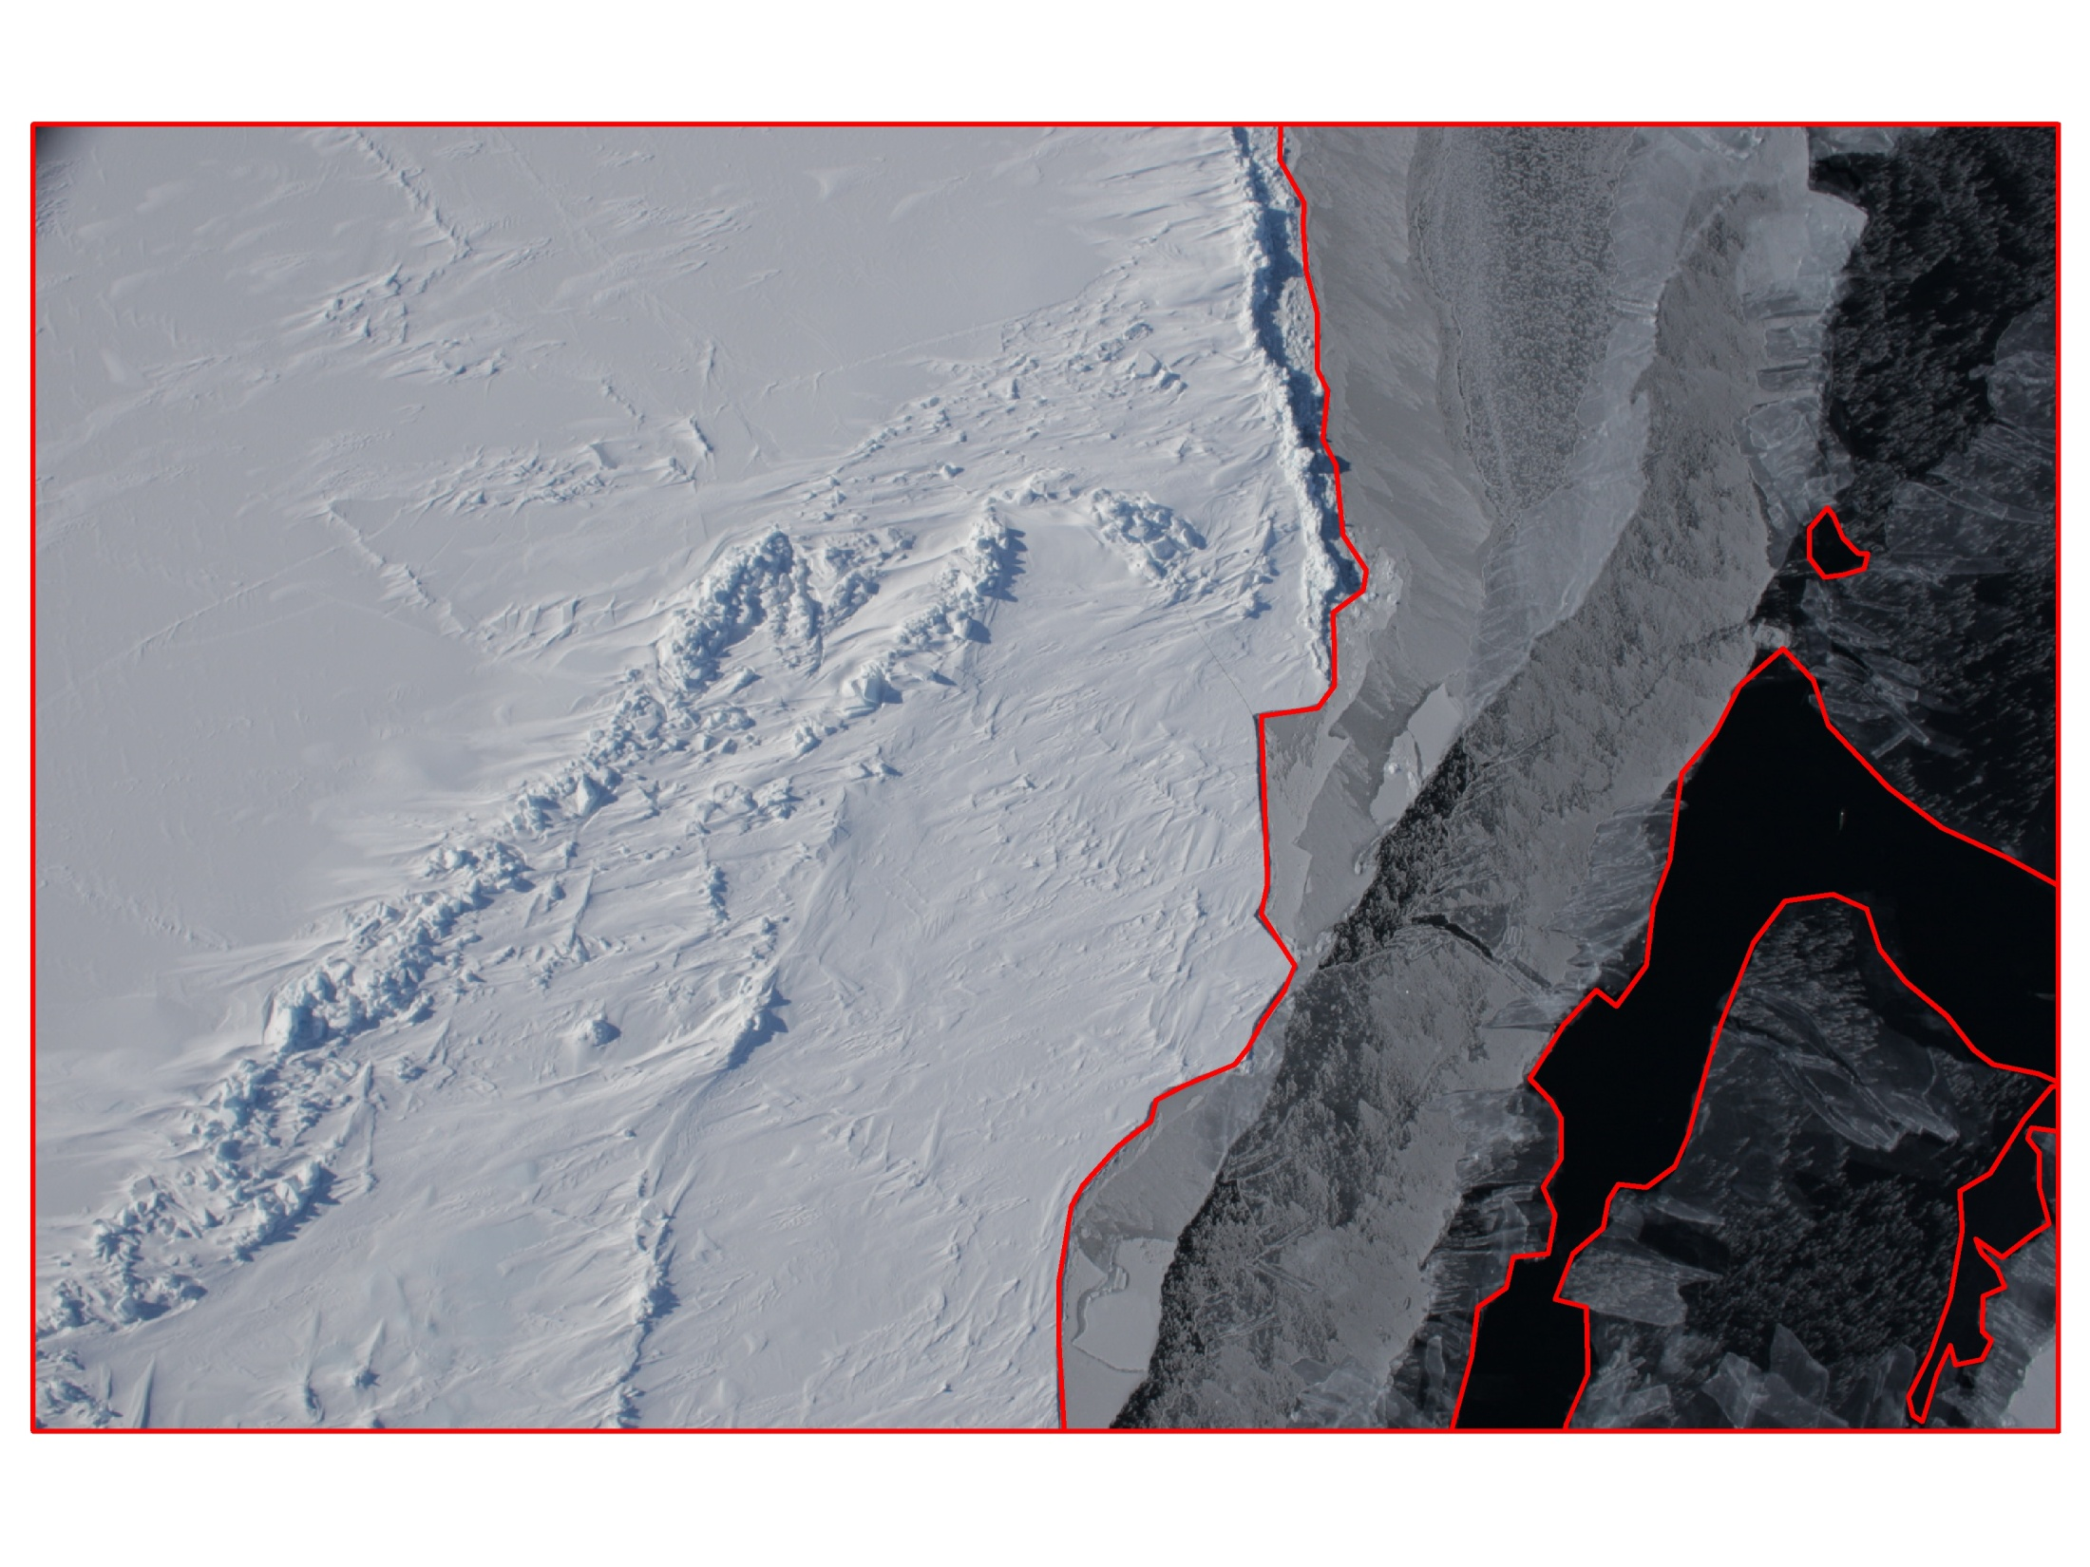
Digital georegistered aerial photography (2,685 images)
Light ice/new ice
Old ice
Open
water

Slide 31
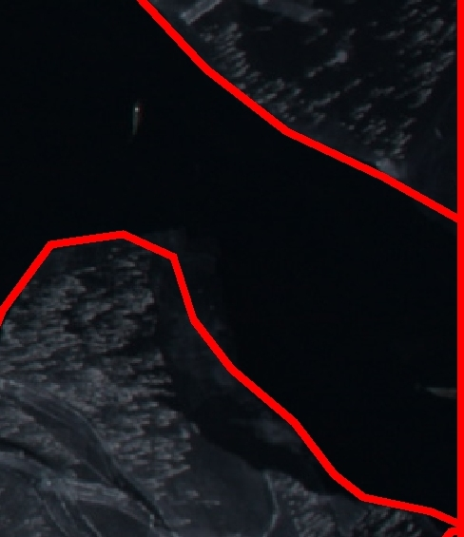
Open
water

Slide 32
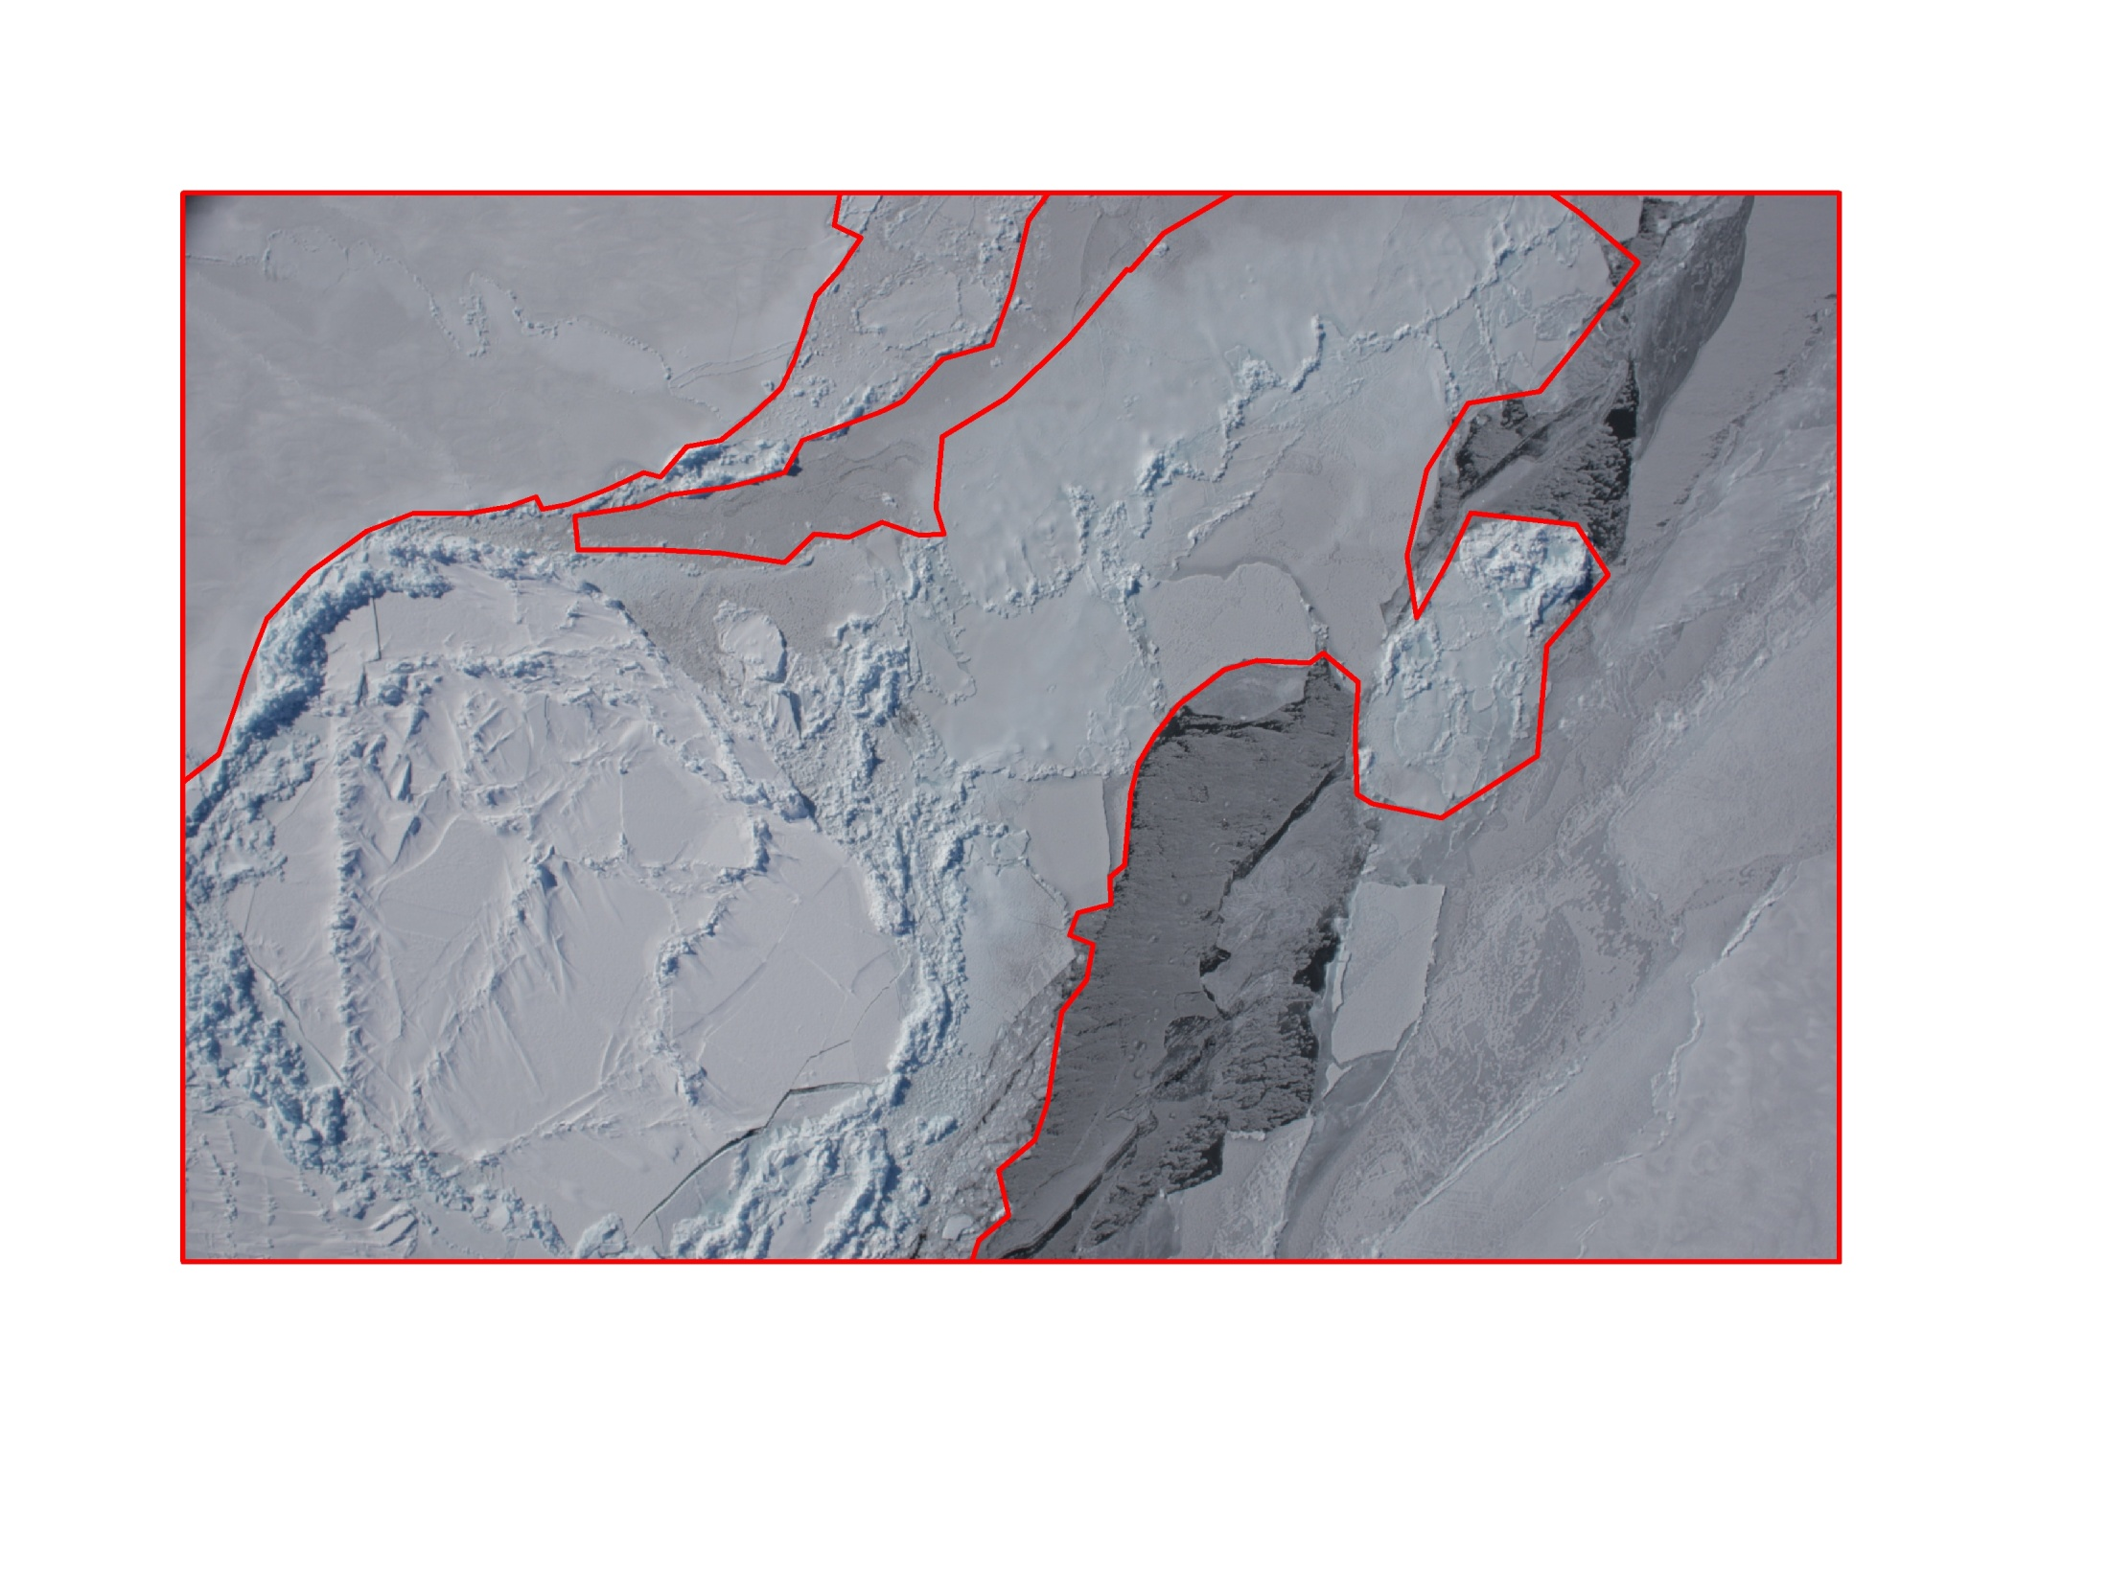
New ice can be habitat for narwhals
Old ice
Light ice/new ice

Slide 33
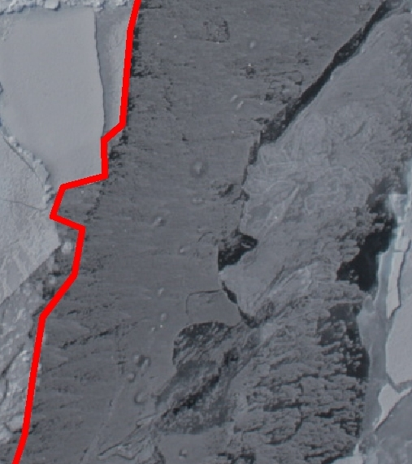

Slide 34
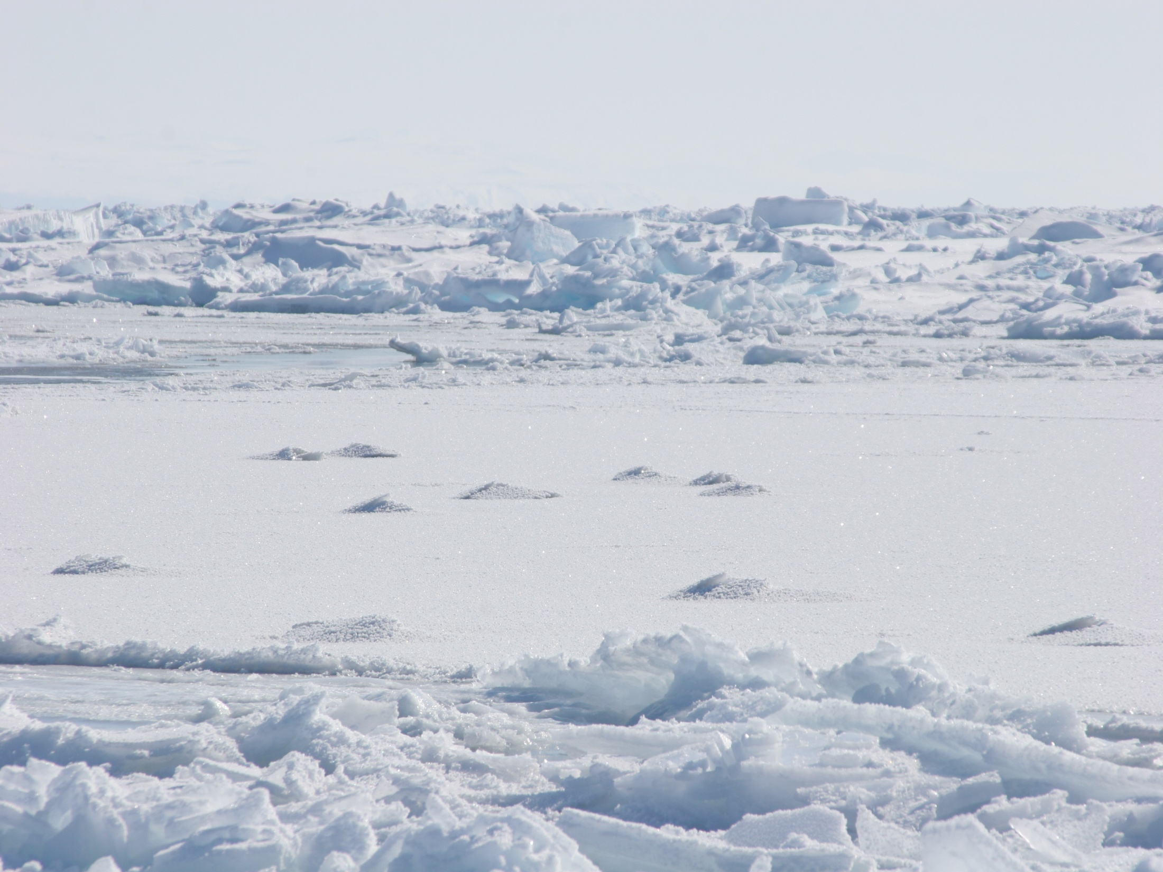
1565 digital images along the trackline (71 sq km).
On average, 196 (SD 53) images were taken on each transect.
3.2% (SD 15.9%) open water estimated from in situ images.
Laidre and Heide-Jørgensen. 2011. Marine Ecology Progress Series 423:269-278.

Slide 35
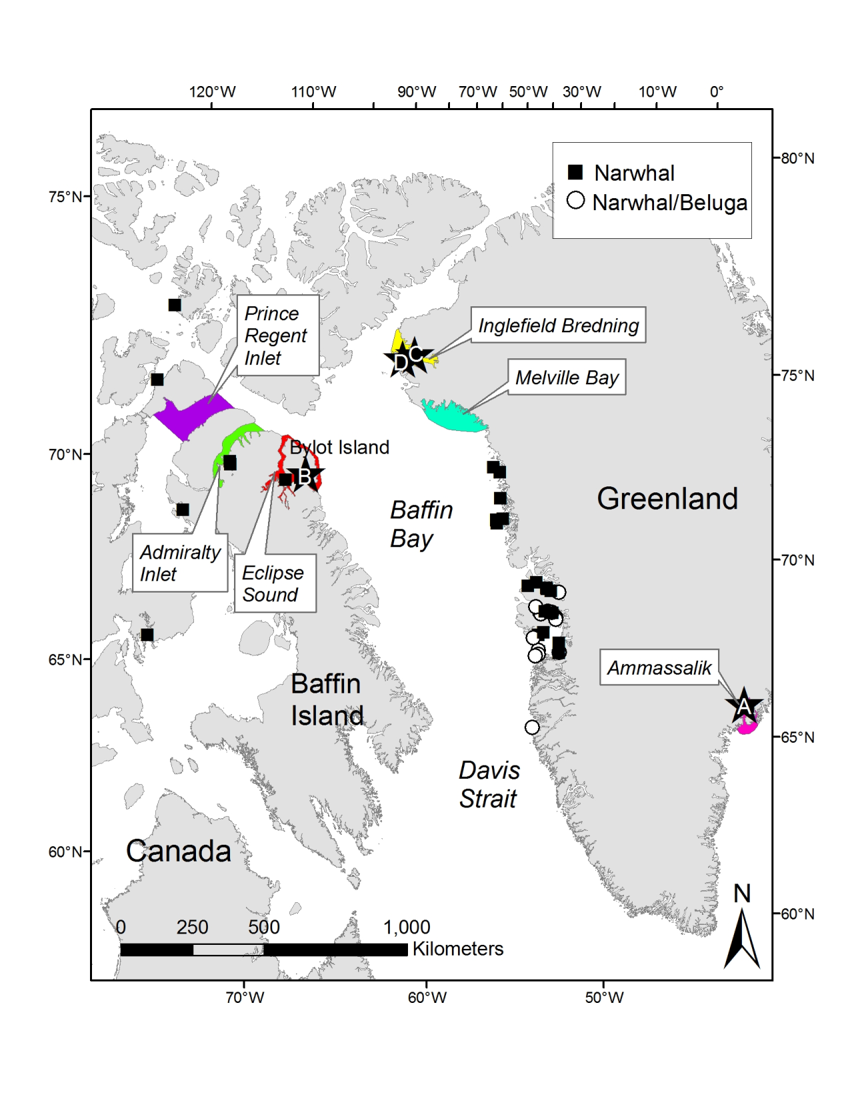
Calculated trends in freeze-up timing (date when sea ice concentration rises above some threshold) on the 6 largest narwhal summering areas
Autumn1979-2010
Laidre et al. 2011. Polar Biology
Notes:
Of course, lack of oxygen isn’t the only problem whales face in ice entrapments.
This is the only hole in the ice that narwhals can use to breath through.
It is important to note many of these ice entrapment events can occur offshore in areas where very few humans ever go, and may likely go undetected. This is particularly true because of the low level of precision obtained even in intensive narwhal population surveys in the summer.
Remember also, narwhals are feeding intensively on these wintering grounds, and reduced Greenland halibut abundance due to a commercial fishery, together with increased restriction on winter dispersal, will likely influence narwhal foraging success and may even reduce the carrying capacity for narwhals on the wintering grounds.

Slide 36
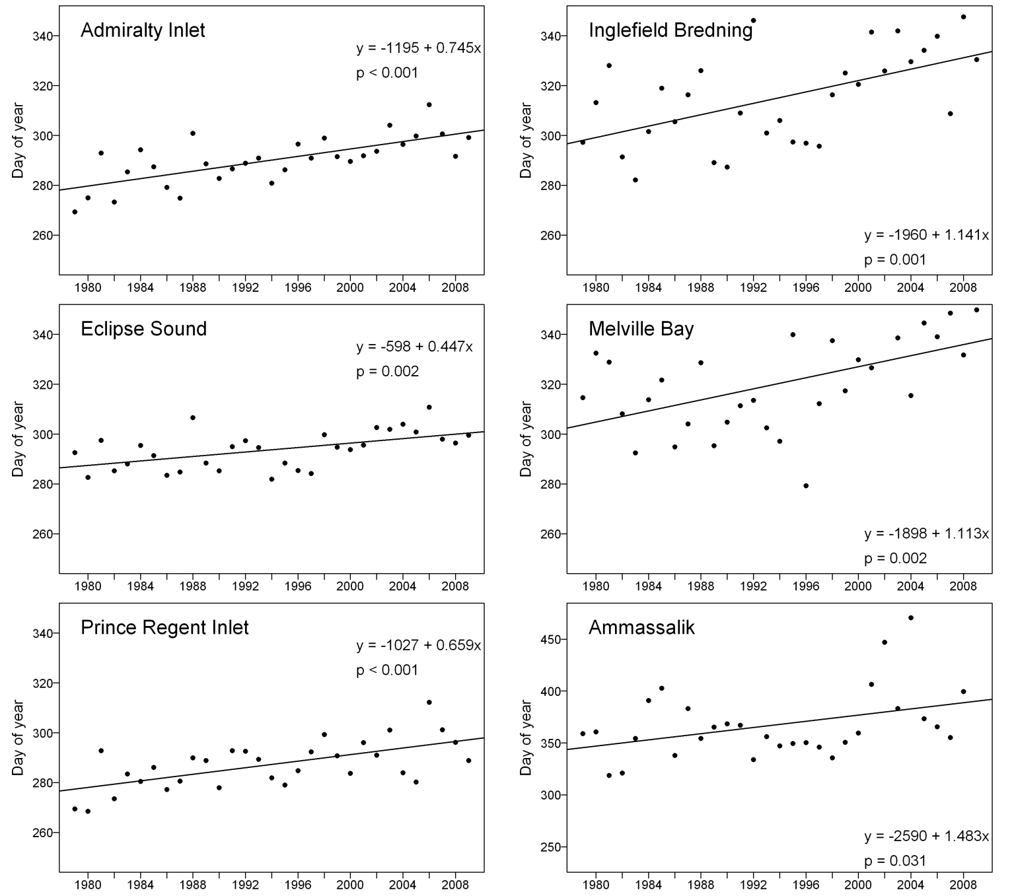
Strongly positive and significant trends (p<0.001) in progressively later dates of freeze-up in all summering areas
Freeze-up occurs between 0.5 and 1 day later per year, or 2 to 4 weeks later, over the 31-year time series.
Laidre et al. 2011. Polar Biology
Notes:
Of course, lack of oxygen isn’t the only problem whales face in ice entrapments.
This is the only hole in the ice that narwhals can use to breath through.
It is important to note many of these ice entrapment events can occur offshore in areas where very few humans ever go, and may likely go undetected. This is particularly true because of the low level of precision obtained even in intensive narwhal population surveys in the summer.
Remember also, narwhals are feeding intensively on these wintering grounds, and reduced Greenland halibut abundance due to a commercial fishery, together with increased restriction on winter dispersal, will likely influence narwhal foraging success and may even reduce the carrying capacity for narwhals on the wintering grounds.

Slide 37
Summary
Multi-year fidelity to winter foraging regions in variable environments may confer ecological benefits (i.e., predictable resources, even when energy gain is not consistently high).
~25% of Baffin Bay population in surveyed area - movements that localize over small areas with very dense sea ice suggest high preference.
Loss of sea ice or changes in freeze up timing, increased anthropogenic impacts (shipping, NWP transit) and seismic exploration all represent threats because the areas are small.

Slide 38
Acknowledgements
NASA ROSES Grant# NNX08AF71G
Greenland Institute of Natural Resources, Nuuk
Department of Fisheries and Oceans, Canada
University of Washington Applied Physics Lab, Seattle
P. Nicklen

